Slide 1
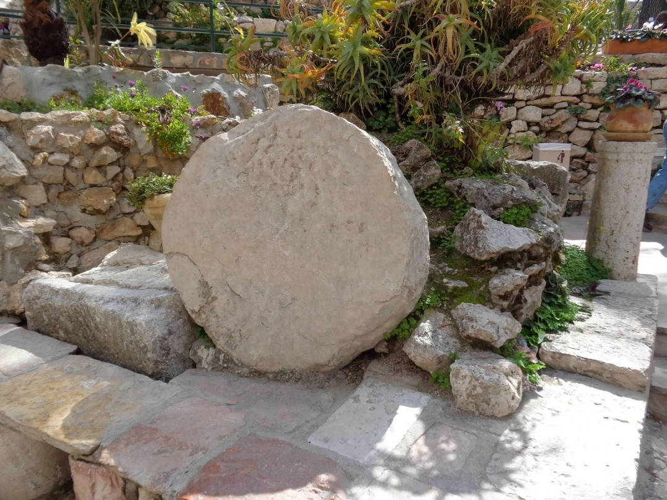
The Stone is Rolled Away!
Easter Sunrise Service
Sponsored by
Fairfield Glade Council of Churches
Sunday, April 5th 6:00AM
Fairfield Glade United Methodist Church
231 Westchester Drive

